Slide 1
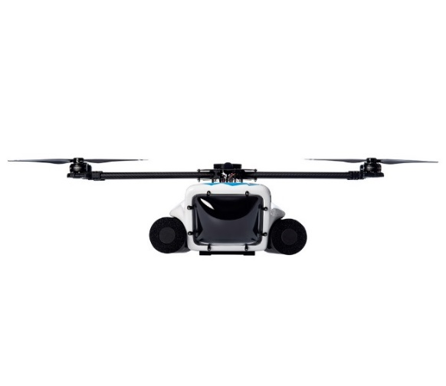
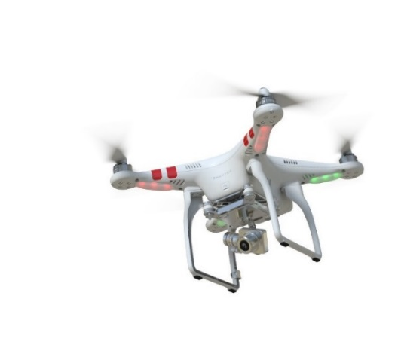
Mosquito Assessment and Control Unmanned Aerial Systems (MAC-UAS) Program
Integration of Small Unmanned Aircraft Systems (sUAS) in Vector Control
Scott Schon, Pilot
Ev Ortiz, Pilot

Slide 2
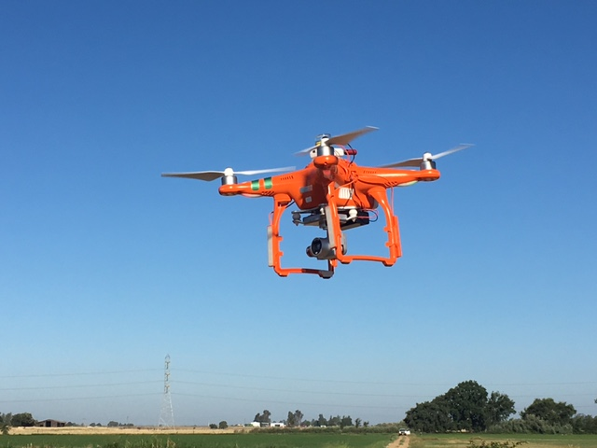
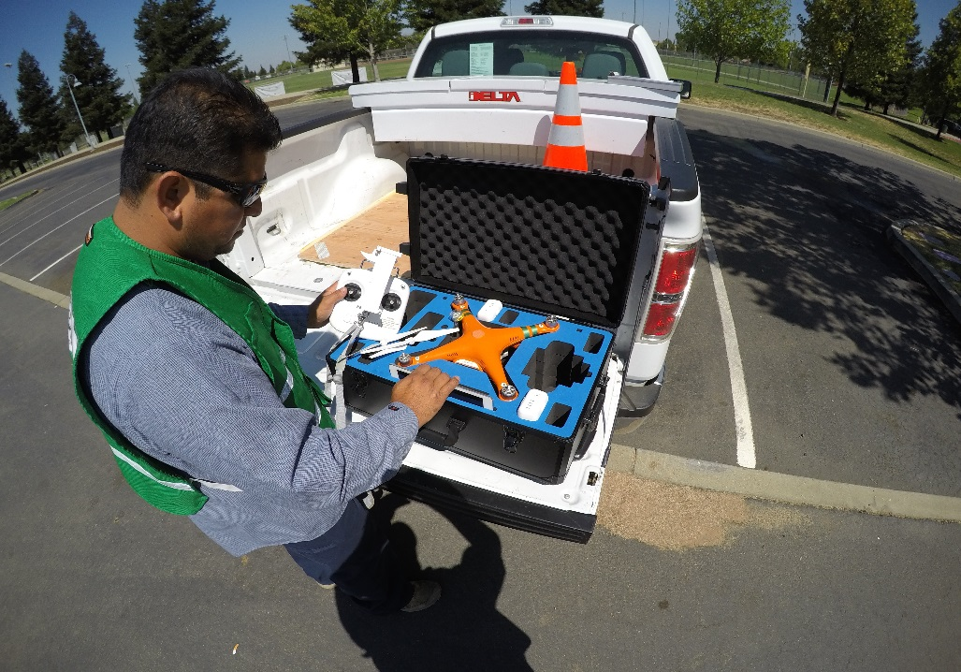
MAC-UAS Program
Phase 1: Training and Infrastructure
Phase 2: Missions under Part 107
Phase 3: Missions needing waivers
Phase 4 : Precision Public Health Insecticide Applications

Slide 3
First P3S Visual Assessment Missions
Dec 14
First Vernal Pool Monitoring Mission
Feb 22
First Log Decks Monitoring Mission
Mar 8
First Atmospheric Measurement
Pilot Training
Jun 6
Nov 5
Catastrophic Crash of HPV1
Phantom 3 Standard (P3S)
HexH2O Pro V1 (HPV1)
May 4
HexH20 Pro V2 (HPV2)
Nov 16
Jan 24
Jul 10
2016
Oct
Nov
Dec
2017
Feb
Mar
Apr
May
Jun
Jul
Aug
2017
Oct 31
Jan 23
Today
Project Start
Board Resolution supporting UAS
Jun 27
Received Daylight Flight Waiver
Jul 11
Safety Management System Cert
Phase 1: Training
Oct 31 - Jan 31
Phase 2: Mission Development and Implementation
67 days
Feb 1 - Jun 27
105 days
Phase 3: Part 107 Waivers and Mission Implementation (Part 107 Daylight Flight Waiver)
Jun 1 - Aug 21
58 days

Slide 4
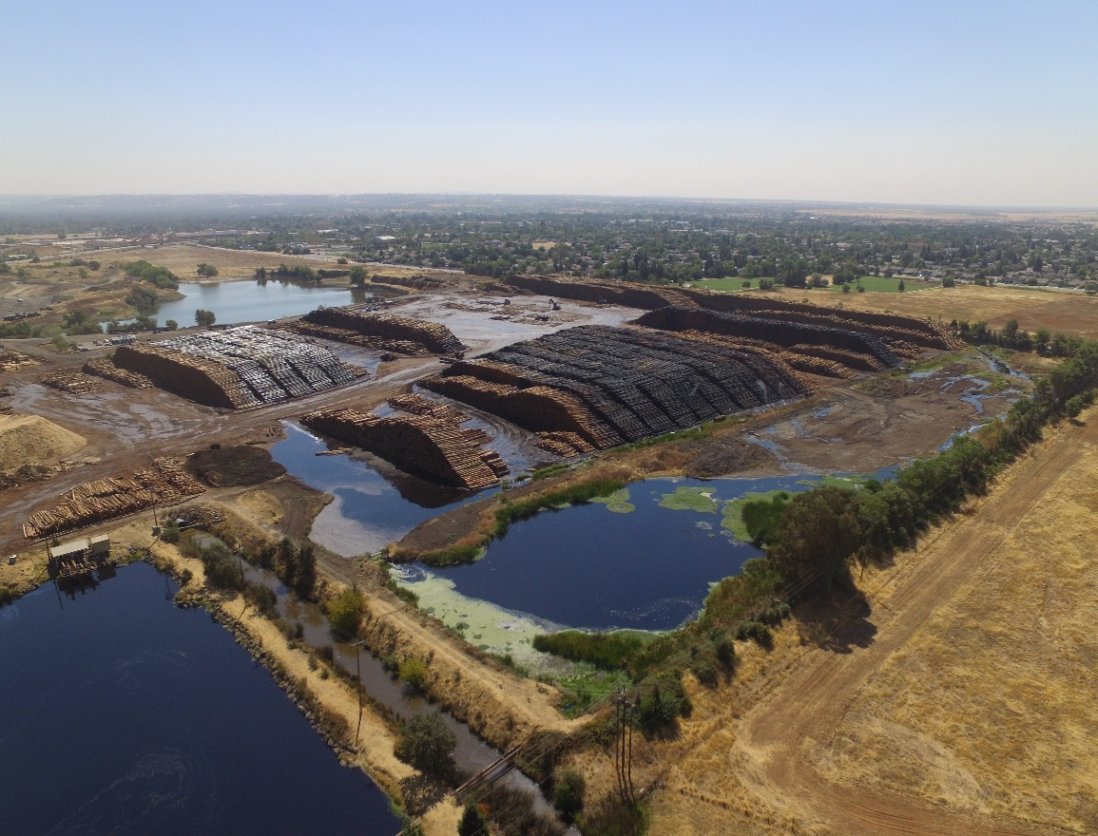
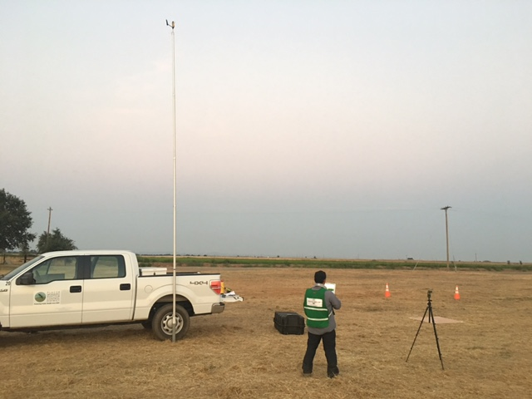
UAS Mission Types
Atmospheric Measurements
Aerial Photographic Monitoring
Visual Assessment of Mosquito Habitat

Slide 5
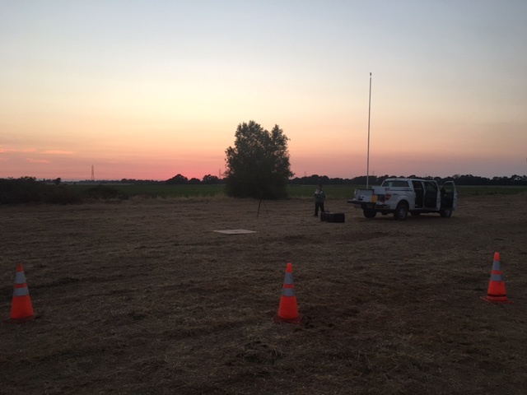
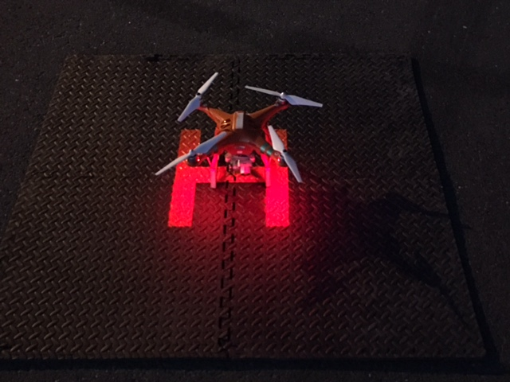
Atmospheric Measurements
Purpose: To detect presence or absence of temperature inversion and relative humidity in order to support manned aerial and truck adulticide operations.

Slide 6
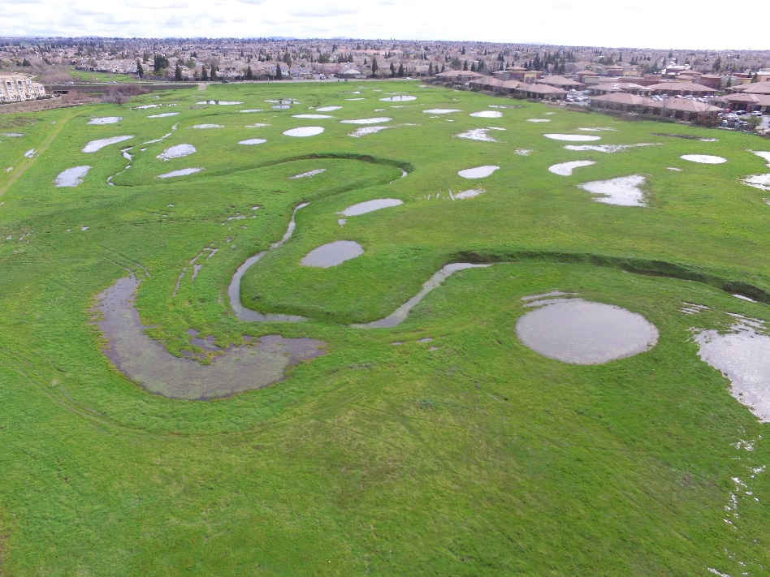
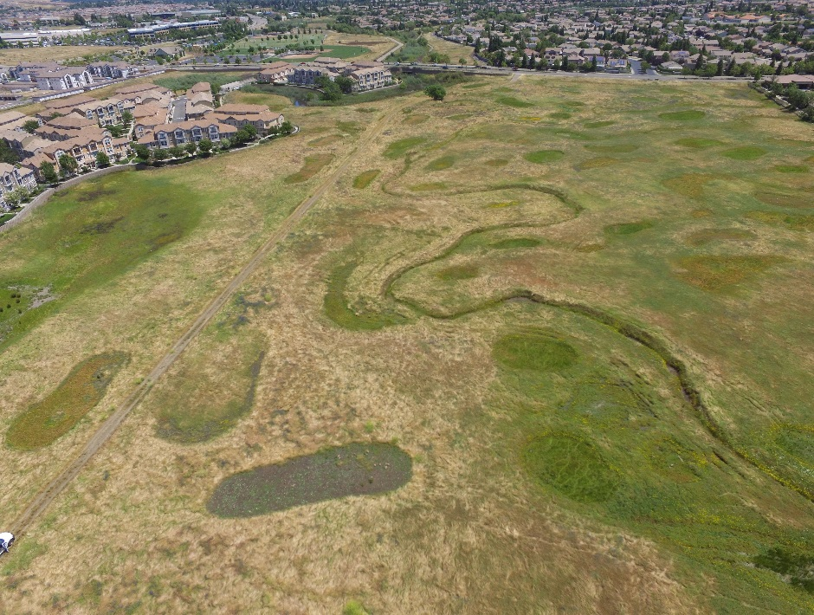
Aerial Photographic Monitoring
Purpose: Document change of a particular site over time with regard to standing water or other land use relevant to mosquito management.

Slide 7
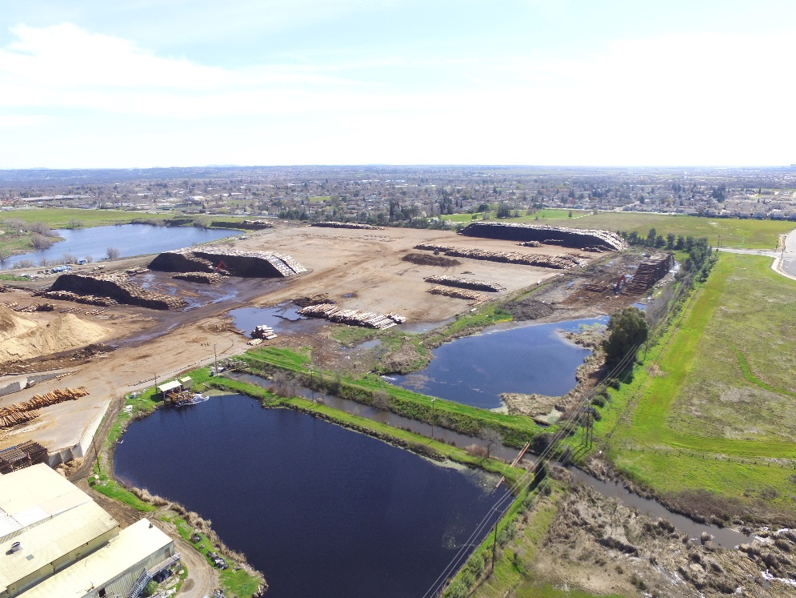
Aerial Photographic Monitoring
(March 8, 2017)
(August 10, 2017)

Slide 8
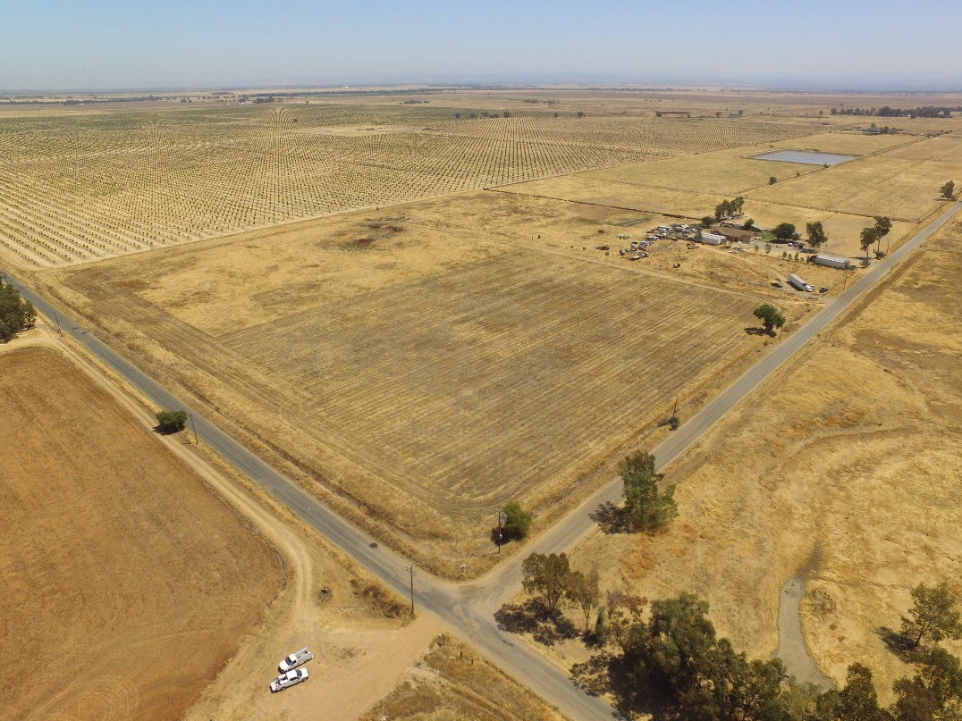
Visual Assessment of Mosquito Habitat
Enhanced Surveillance WNV Response

Slide 9
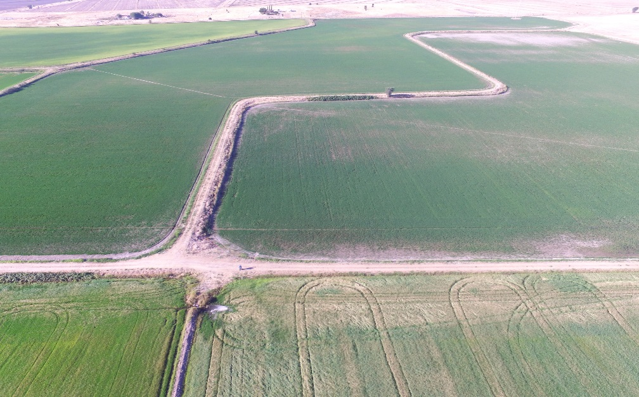
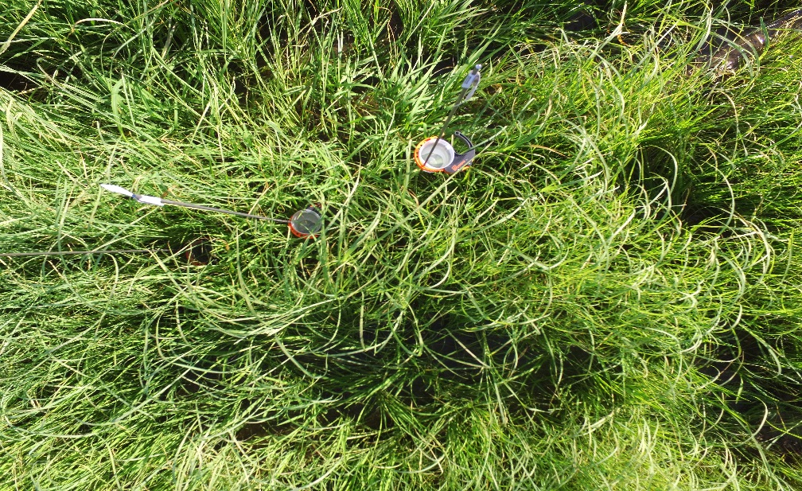
Visual Assessment of Mosquito Habitat
Beaver Dams (Below)
Rice Fields (Right)

Slide 10
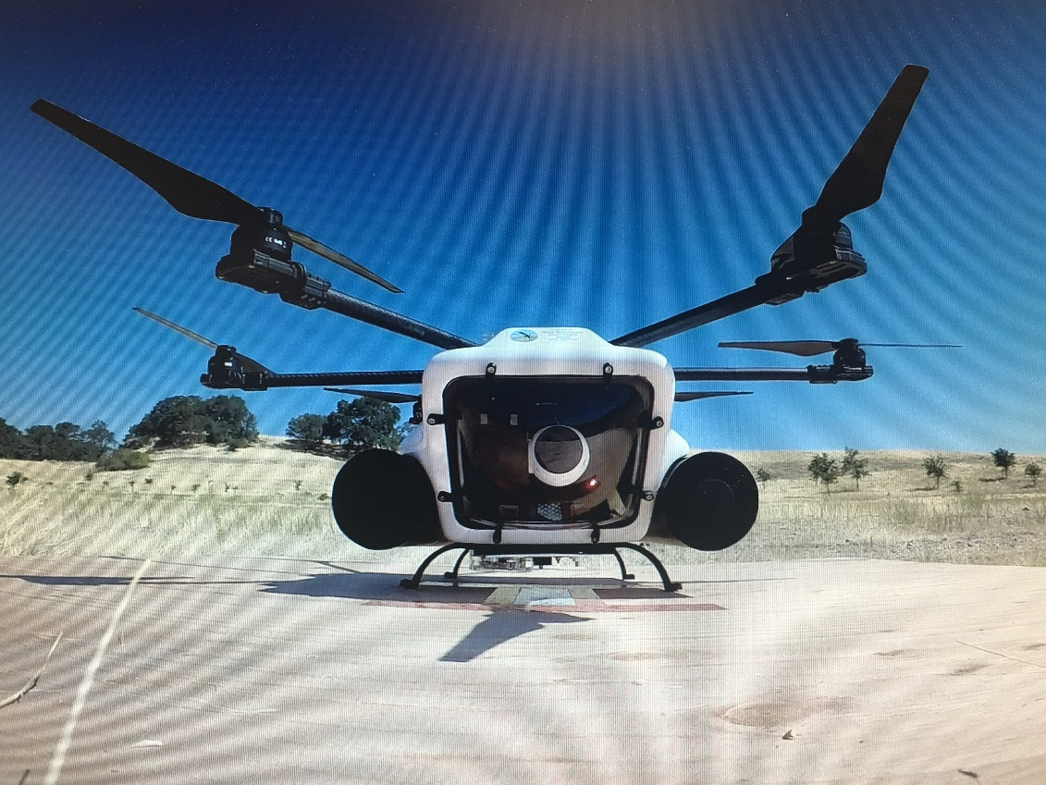
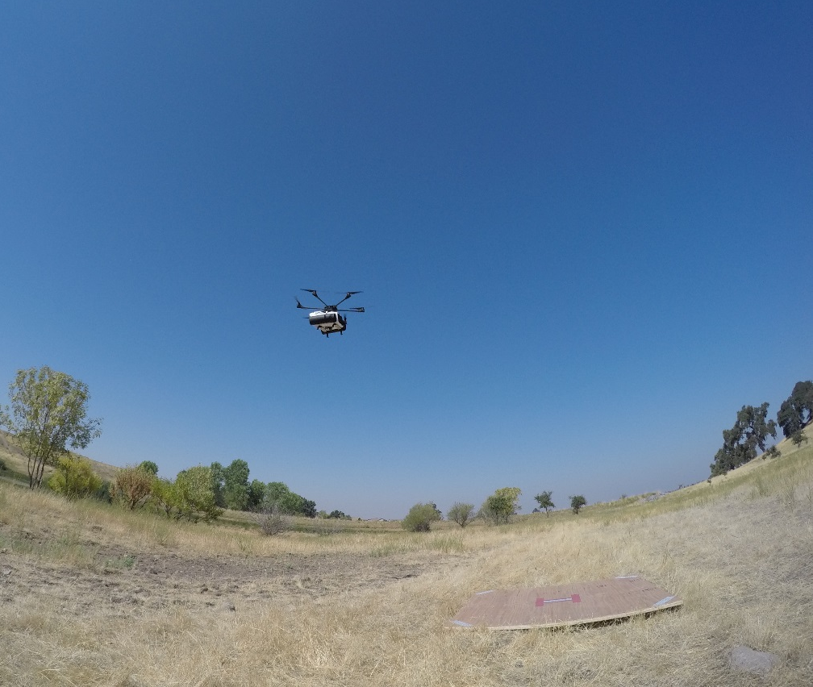
Additional Mission Types
Mosquitofish and Larvae Detection
Deploy/Pick-Up Adult Mosquito Traps

Slide 11
Safety Certification
MAC-UAS received safety certification from Wolf UAS on August 17, 2017
We received manuals and training in the following areas:
Flight Operations
Accident-Incident Response
Safety Management Systems
Safety and Ops Training

Slide 12
Regulatory Road-Map to UAS Applications of Public Health Pesticides
Title 14 CFR Part 107
FAA Standard for Commercial UAS operations
Public CoA
Addresses restrictions under Part 107 (Part 137 and Airworthiness Certification)
Pest Control Aircraft Pilot Certification
State Law
AB 527 will allow some Unmanned Pilots to qualify to take test
Requires aircraft to apply
Waivers available to some restrictions

Slide 13
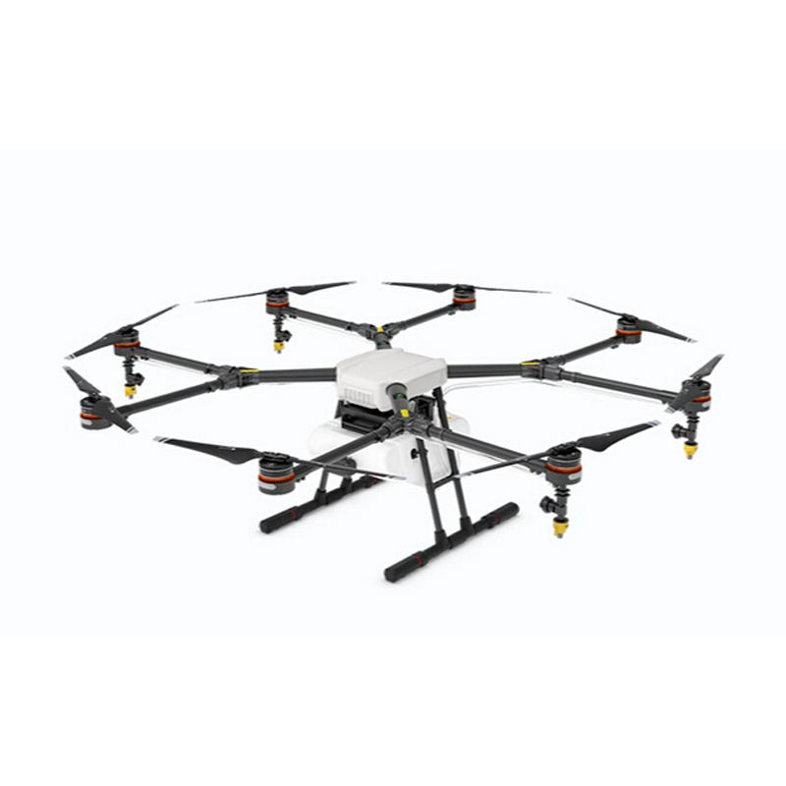
Precision Public Heath Applications by UAS
Larvacide Treatments
Adulticide Treatments
DJI AGRAS- MG1(s)
10L (2.6 gal) tank
24.5 kg (49 lbs) max take off weight
>5 Feet Diameter x 19 in tall

